Slide 1
Unit 2 Models of E Governance

Slide 2
What is digital governance?
When a marketing team and a technology team plans to launch a marketing website or mobile application, they always debate on selection of website technologies, information architectures, and content management systems.
The IT team always focuses on website design, where content management team is always stuck between marketing and compliance.
A round table of all stakeholders from IT, Finance, Marketing, Content as well as Legal teams with approved budget, requirement documents, and use cases are struggling on the decision making process.
Even in presence of rich interface design, robust(strong) technology platform, and strong content strategy(satisfying business requirement), most of the times, digital initiatives are failing due to underlying digital governance issues.

Slide 3
What is digital governance?
It is now important to have a digital governance framework in place, to take the most effective decision while executing a digital strategy(plan of action).
The framework sets the rules for digital engagements related to ownership of digital content like information, graphics and social media updates.
Digital governance also ensures flexibility, raises quality, and manages risks of security breaches and lawsuits.

Slide 4
What is digital governance?
Digital governance is a framework for establishing accountability, roles, and decision-making authority for an organization’s digital presence which means its websites, mobile sites, social channels, and any other Internet and Web-enabled products and services.
Digital governance is Critical for Digital transformation
Having a well-designed digital governance framework minimizes the number of tactical debates regarding the nature and management of an organization’s digital presence by making clear who on your digital team has decision-making authority for these areas:
Digital strategy
Digital policy
Digital standards

Slide 5
What is digital governance?
Digital strategy is to identify right technologies to gain maximum value and to identify right people who can execute the digital strategy.
Right technologies means, which fit with the business processes and operations and right people, should have the knowledge and skills to evaluate the impact of digital in the marketplace and can respond to the impact.
The digital strategy team should always be a mix of senior executives, business analysts, and digital experts.
Digital policies are guidelines to manage risk and they ensure organization’s core interests are served while executing the digital strategy.
Digital policies are the combination of suitable corporate policies, vertical industry policies, and national policies which guards the content developers and information managers to generate online publication across multiple digital channels.
Digital policies do not control information quality but safeguard the organization from lawsuits related to branding, intellectual property rights, privacy and security of confidential information, domain names, and accessibility related issues.
Digital standards comprise of quality specifications related to designs, data, servers, network, even extended to organization values.
They are defined, keeping in mind about the industry standards and digital customer experience.
Senior executives and digital experts play a crucial role to define the standards by bringing in digital benchmarks and the organization values.

Slide 6
What is digital governance?
It enables responsiveness by clarifying roles, responsibilities and connections for a collaborative team
As Lisa Welchman explains in her book, Managing Chaos: Digital Governance by Design, “Digital governance is a discipline that focuses on establishing clear accountability for digital strategy, policy and standards. A digital governance framework, when effectively designed and implemented, helps to streamline digital development and dampen debates around digital channel ‘ownership’.”
A lack of digital governance causes many of the same problems that a lack of association governance causes for an organization: a lack of accountability, a lack of clarity about roles and responsibilities, and an inability to make good decisions in the face of change and uncertainty.

Slide 7
Models of Digital Governance
Still evolving in developing countries
There are a few basic theoretical models of Digital Governance, which may serve as a guide to implant the idea into reality.
There are two characteristics of the new technologies that remain the same in various models.
Models are based on the inherent characteristics of ICT such as enabling equal access to information to anyone who is a part of the digital network and de-concentration of information across the entire digital network, connecting all sources of information.
Information does not reside on any particular node but flows equally across all the nodes in the Digital Governance Model.
Does not embed the common hierarchical information flow model that leads to the unequal distribution of information and hence skewed power relations.

Slide 8
Models of Digital Governance
Hierarchy is inherent in the government departments where equity based information flow may not always be compatible with government functioning.
Hence, appropriate administrative reforms and some reengineering is required before the real implementation of e-governance.
Models of e-governance are fundamentally different in developing and developed countries due to differences in basic conditions and perspectives and expectations from good governance.

Slide 9
Models of Digital Governance In Developing Countries
• Broadcasting/Wider Dissemination Model
• Critical Flow Model
• Comparative Analysis Model
• Mobilization And Lobbying Model
• Interactive Service Model
• E-governance Maturity Model
These models exhibit several variations dependent on the local situation and the governance functions carried out through these models

Slide 10
Broadcasting/Wider Disseminating Model
In Broadcasting model, governance-related information, which is already available in the public domain, is further spread into the wider public domain using modern information and communication technologies.
This raises awareness among the citizens about ongoing governance processes and government services that are available to them and how they can benefit from them.
It allows citizens to form an opinion of the government and its administration based on services delivered to them- whether the government services were available to them, and the quality of service received.
This could be judged in terms of time spent, number of visits required and level of bureaucracy encountered to avail the services.
Equipped with this information, the citizens can feel more empowered to voice their concerns and influence governance processes to make them more efficient.

Slide 11
Broadcasting/Wider Disseminating Model
The application of this model using appropriate technologies, could reduce the "information failure situations" where citizens are unaware of new and existing services being provided by the government.
It can also provide as alternative channel to people to stay updated of governance related information and to validate information received from other sources.
When this model is widely spread, it eventually corrects the situation of communication failure and gives people information related to the government so that they can come up to consensus and decide the future course of action.

Slide 12
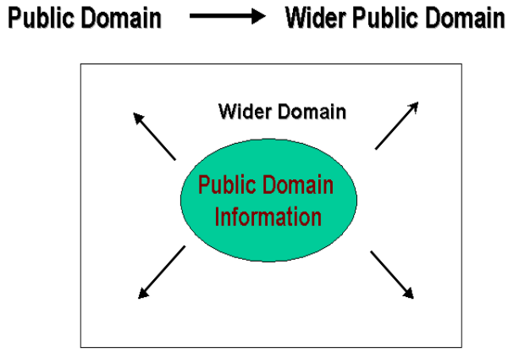
Broadcasting/Wider Disseminating Model
• Laws and Legislations
• Govt. Offices and Officials
• General Health Information
• Environmental Problems
• Disaster Warning
Africa News Online, Kabissa Network, Wougnet, Earth Negotiations Bulletin (ENB),Communication Initiative

Slide 13
Broadcasting/Wider Dissemination Model
Principle
– Based on dissemination of governance related information relevant to better governance that is already in the public domain into wider public domain through the use of ICT and convergent media.
– Rationale (Justification)
A more informed citizen is able to understand the governance mechanism better and is more empowered to make informed choices and exercise its rights and responsibilities.
There is a greater likelihood that the society in which the individuals are equally informed will ensure that the agenda and forms of governance are not biased to favor a few.
• The widespread application of this model gradually corrects/reduces the situation of information failure and provides people with the basic government-related information to come to a common understanding and decide upon the future course of action.
It can also provide as alternative channel to people to stay updated of governance related information and to validate information available in the local domain from external sources.

Slide 14
Broadcasting/Wider Dissemination Model
• Applications
1. Putting government laws and legislations online
Making available the names, contact addresses, e-mail
and fax numbers of local/ regional/ national government officials online
Making available information such as governmental plans, budgets, expenditures and performances reports online.
Putting key court judgements / judicial statements which
are of value to common citizens and creating a precedence for future actions online, through key environment related judgements, State vs. Citizen decisions etc

Slide 15
Broadcasting/Wider Dissemination Model
Evaluation (Pros and Cons)
• This model is the first step to more evolved forms of digital governance models and is the most crucial one as it catalyses free access and flow of information to all segments of the society and hence can be referred as the building block of digital governance.
• National and state Governments therefore need to aggressively adopt this model if they want to create an environment for enhanced participation of its citizens in the governance processes.
Simultaneously, the civil society groups should demand for such models to enable access to governance information which can improve the quality of lives of people.
• The model however loses its effectiveness where free-flow of information is not encouraged or is not objective.
This can happen in countries where freedom of speech and expression, or political freedom is restricted,
• Tight governmental controls and bids to censor the content being transmitted through this model would be the bane(destruction) of this model.
• The responsibility is therefore both on governmental organizations as well as civil society organizations to ensure such models continue to proliferate(multiply).

Slide 16
Broadcasting/Wider Dissemination Model
Evaluation (Pros and Cons)
The model also loses its effectiveness in situation of optimal ignorance.
This happens when citizens are indifferent / not motivated to act upon information available to them, or when governments and decision-makers take wrong decisions, not because of absence of information, but complete disregard of available information.
Also, the model is pointless when free flow of important content is not encouraged

Slide 17
Organizations / Projects based on the Wider Model
• India
Directory of official websites of Government of India: http://goidirectory.nic.in/ministry.htm
National Informatics Centre (India) is the official website of the Government of India. It makes available information on government ministries - its projects and schemes, Indian laws and legislation, contact details of local government offices and key position holders online for public access.
• Brazil
Brazil's official national E-Government website: http://www.brazil.gov.br
The website provides comprehensive information on Brazilian government as well as links to integrated citizen services.

Slide 18
Organizations / Projects based on the Wider Model
• South Africa
Chapter 2 Network: http://www.advocacy.org.za
The Chapter 2 Network is a center to clear communication and information for social justice issues in South Africa.
This network distributes information about research and political intelligence, support campaigns and legislation scrutiny to civil society organizations involved in social justice.

Slide 19
Organizations / Projects based on the Wider Model
• Global
Earth Negotiations Bulletin: http://www.iisd.ca/voltoc.html
A reporting service that keeps citizens around the world informed about global environmental negotiations, processes and decisions.
It’s of primary value to governments and the people especially in the developing countries so as to record international decisions and take the necessary precautions.
It has immense value for people and government officials alike in developing countries to keep track of global negotiations taking place in the west and be more informed about them.

Slide 20
Critical Flow Model
A critical flow model of e-governance is a digital governance that’s operates within private and public domains.
This model has been able to address and access information such as:
Violations of human rights
Security threats
Information on corruption both in the public and private sectors
The green ratings of a company i.e. energy reduction and environment protection

Slide 21
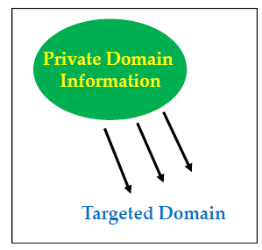
Critical Flow Model
Critical/private Domain Targeted/Wider Public Domain
• Corruption Information
• Company’s Green Ratings
• Human Rights Violations
• Scientific Research
Greenpeace Campaigns, KACA,
VERCON (FAO), HealthNet Staging
Posts, Telecentres (Sangonet-SA,
UNDP-Ukraine, Gyandoot-India)

Slide 22
Critical Flow Model
• Principle
– The model is based on disseminating/channeling/distributing information of critical value/key value to a targeted audience or into the wider public domain through the use of ICT and convergent media.
Targeted audience may include media, affected parties, opposition parties, judicial bench, independent investigators or the general public.
– This model Requires the users to understand the significance of a particular information/any data set and using it strategically.
The use of this model requires a foresight of:
Understanding the "critical and use value" of a particular information set
How or from where this information could be obtained
How could the information be used strategically
Who are the best target group for such information- the position of users for whom the availability of this information will make a huge difference in implementing good governance.

Slide 23
Critical Flow Model
• Principle
– May also involve locating users to whom the availability of a particular information set would make a critical difference in initiating good governance.
– The strength of critical-flow model is the concept of 'distance' and 'time' becomes redundant when information is hosted on a digital network.
This reduces the cases of exploitative governance possible earlier due to time lag between availability of information to different users.
– Once available on the digital network, the information could be used advantageously- by instantly transferring the critical information to its user group located anywhere or by making it freely available in the wider public domain.

Slide 24
Critical Flow Model
• Applications
Making available information on corruption of a particular government ministry or government officials available to its electoral constituency/body or to the concerned regulatory body or governing council.
Making available Research studies, Enquiry reports and appraisals/impacts commissioned by the government or Independent commissions available to the affected parties.
Making or Availing records of Human Rights violation and criminal impeachment records against government officials available to Judiciary, NGOs and concerned citizens.
Making environment related information available to local communities.
For example, information on radioactivity spills which are health hazards, effluent discharge in rivers, green ratings of a company to concerned community etc.

Slide 25
Critical Flow Model
• Evaluation (Pros And Cons)
– This model is more directed in terms of its information content and its intended users.
– By focusing on the critical aspect of information and locating its likeable users, the model corrects information failure, raising awareness about the bad governance practices, and acts as a hindrance to bad governance practices.
– It informs people about specific cases of state-failure and bad-governance to build up a case for concerted(Coordinated) action.
– This model informs people about particular instances of political failure
and improper governance.
– At the same time, the model exerts indirect pressure on the concerned governance institution / policy-making body to move away from optimal ignorance attitude to reform, and take into cognizance the interest and opinion of the masses in decision- making processes.
– The responsibility of creating such models may lie more with the civil society organizations to emerge as an effective watch guard to government policies and actions. The government by itself may not have sufficient incentive and an attitude towards sharing such information.

Slide 26
Critical Flow Model
• Evaluation (Pros And Cons)
– The model will not work in cases where government mechanisms do not foster public debates and censure (criticize) all information of critical nature.
– It will also fail where the government maintains a tight control over all information and it remains restricted to top few levels of the government.
– This model unlike the Broadcasting/ Wider-Dissemination model would be more effective in situations of Optimal Ignorance of the Government.
Optimal ignorance occurs when injudicious decisions are taken not in the absence of availability of enough information but because of disregard of information by the decision-makers.

Slide 27
Organizations / Projects based on Critical Flow Model
• India
Central Vigilance Committee (India): http://cvc.nic.in
– An initiative on e-vigilance.
The website provides free-access information to citizens about government officials who have been indicted on judicial charges relating to corruption and have been advised penalty.
People can also file complaints against any public servant who fall within the jurisdiction of the Commission.
Project VIGEYE: http://www.vigeye.com/
Vigeye (Vigilance Eye) is a citizen-centric initiative, wherein citizens join hands with the Central Vigilance Commission in fighting corruption in India.
Project Vigeye is the platform through which vigilance information flows freely through common public, the government agencies and the vigilance commission, making it possible to achieve a step jump in improving the corruption index of the nation
• Bangladesh
– Human Rights Portal: http://www.banglarights.net
– The Bangladesh Human Rights Network actively promotes human rights reforms both within Bangladesh and across geographical and political boundaries, and supports women, children, and marginalized communities in resisting social oppression(unjust
treatment).

Slide 28
Organizations / Projects based on Critical Flow Model
Global
Transparency International's Corruption News: http://www.transparency.org/press_moni.html
A trial service run by Transparency International called the "The Daily Corruption News" which reports on corruption from around the world.
The daily corruption news has been coming out since May 2000.
China: Human Rights in China: http://www.hrichina.org/
Human Rights in China (HRIC) is an international non-governmental organization founded by Chinese scientists and scholars in March 1989.
It strives to make information on human rights issues accessible to the Chinese people through short-wave Chinese radio broadcasts, overseas Chinese publications, and an evolving virtual media hub on human rights.

Slide 29
Comparative Analysis Model
Comparative Analysis Model is one of the least-used but a high potential e-governance model for developing countries.
The model can be used to empower people by comparing cases of bad governance with those of good governance and identifying specific aspects of bad governance, the reasons and people behind them, and how the situation can be improved.
The model is based on using immense capacity of ICT and social media tools to explore given information sets with comparable information available in the public or private domain.
For instance, if a given amount of money can build 5 primary schools in District 'A' in a country, then why does the same amount of money build only 2 schools in District 'B'?
Could this be because of corruption of officials and contractors involved, or siphoning of money for other things?
The outcomes are strategic learning's and empowerment, and can lay the basis for possible action, e.g.: filing of right to information (RTI) to find where the money went.

Slide 30
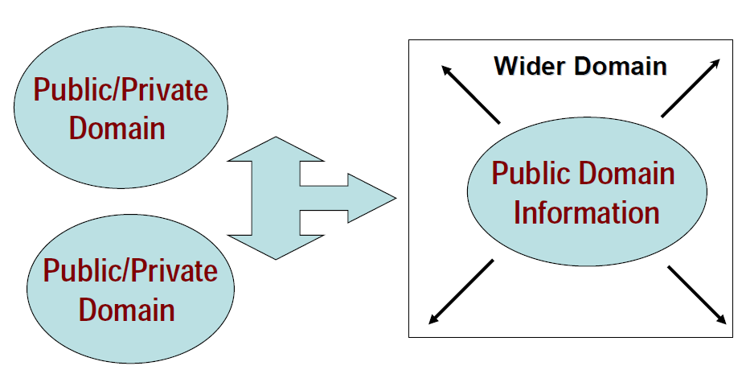
Comparative Analysis Model

Slide 31
Comparative Analysis Model
• Principle
– One of the least-used but a highly effective model that is gradually gaining popularity.
– Based on exploring information available in the public or private domain and comparing it with the known information sets to derive strategic learning and arguments.
– This model Continuously assimilates “best practices” in different
areas of governance and uses them as to evaluate, influence or advocate changes in current governance policies and actions.
– The comparison could be made over a time scale to get a snapshot of the past and present situation (before- after analysis) or could be used to compare the effectiveness of
an intervention by comparing two similar situations. (with-without analysis).
– The strength of this model lies in the boundless capacity of ICT to store information in a retrievable manner and transmit it almost instantaneously across all geographical and hierarchical barriers.

Slide 32
Comparative Analysis Model
• Applications
For gauging(measuring) the effectiveness of current policies by extracting learning from government policies and actions in the past and derive learning lessons for future policy-making.
To evaluate the effectiveness of the current policies and identify key learnings in terms of strengths and flaws in the policies.
Establishing conditions of prior-precedence, especially in the case of judicial or legal decision-making and using it to influence future decision-making.
This could be useful in resolving patent-related disputes, public goods ownership rights etc.
Enabling informed decision-making at all levels by enhancing the background knowledge and providing a rationale for future course of action.
Evaluating the performance and track record of a particular government official or ministry i.e. decision-maker/ decision-making body.

Slide 33
Comparative Analysis Model
• Evaluation (Pros And Cons)
Developing countries can effectively use this comparative model to their advantage as ICT opens access to global and local knowledge products at a relatively low cost.
The model is very much based on the existing sets of information but requires the ability to analyse and bring out strong arguments which could then be used to catalyze existing efforts towards self governance.
Organizations trusted in maintaining this digital platform may use it to track the performance of electoral candidates and share the records in their constituencies.
The model is however reliant on the availability of comparative information sets and the ability of users to analyze and bring out strong arguments or self explanatory graphics from the analysis.
The model becomes ineffective in absence of a strong civil society interest and short public memory, which is essential to force decision-makers to improve existing governance practices.

Slide 34
Comparative Analysis Model
• Evaluation (Pros And Cons)
There is a vast scope of application of this model for judicial advocacy as landmark/key judgments of the past could be used as precedence for influencing future decision making.
Watch guard organizations and monitor-groups could use the model to track the the governance past record and performance and compare with different information sets.
Also, the model relies on the availability of other information’s for comparison and the attitude of people to examine and come up with self-explanatory or strong arguments from the analysis.

Slide 35
Organizations / Projects based on Comparative Analysis Model
• India: Green Ratings Project: http://www.oneworld.org/cse/html/eyou/eyou31.htm
The Centre for Science and Environment in India conducts a survey of how Green the Indian industries are.
The Green Rating Project is an attempt to provide an independent and fair evaluation of the comparative environmental performance of companies, from a perspective which supports responsible industry and encourages poor performers to improve.
Performance reports of companies are shared over Internet and other media and people's opinion is solicited/requested in deciding the greenest environmental managers etc.
India: Comparative Learning from Disasters http://www.cddc.vt.edu/digitalgov/Latur-Gujarat.htm
In the wake of earthquake in Kutch in India (January 2001), there was a lot of comparative learning relating to disaster management drawn from a high intensity earthquake which shook Latur in India in 1993.
The extensive information available on internet on both these earthquakes open up vast scope of comparison by all segments of the society.
Comparison of different Disasters can make people realize that damages to life and property incurred are not just a factor of intensity of the disaster but also dependent on the preparedness of the Government machinery and conducive government policies to handle that disaster.

Slide 36
Organizations / Projects based on Comparative Analysis Model
Philippines
– Vote.ph: http://www.vote.ph
Vote.ph is the non-partisan/non biased, non-sectoral online directory and quick reference center on Philippine elected government officials and election candidates for both the national and the local levels. It serves the purpose of informing voters know who are the electoral candidates running in their respective area and who their incumbent(current) elected officials are.
• France : Opening of a Platform for Comparison of programs of Electoral Candidates http://www.sciences-po.fr/etudiants/electionsM/index.htm
The site compare according to 15 topics the principal proposals of the electoral candidates for the town hall of Paris.
The platform also presents the electoral system of the capital, the biographies of the candidates to the town hall of Paris as well as a list with accompanying notes of links relating to the local elections.
In addition to information which it will offer to the Parisian voters, this experimental project has as an ambition to open a discussion on the interest for the democratic life of comparative electoral sites.
Its users are invited to make share of their comments and reactions for the development of the site for the next elections.

Slide 37
Organizations / Projects based on Comparative Analysis Model
Global
Human Development Indicators http://www.undp.org/hdro/indicators.html
The Human Development Report of UNDP makes use of archived statistical information pertaining to literacy, health, national income etc. as a benchmark to assess the progress made by different countries with regards to their Human Development Index and suggests policy recommendations based on that.

Slide 38
Mobilisation and Lobbying Model
E-Advocacy / Mobilization and Lobbying Model is one of the most frequently used Digital Governance model and has often come to the aid of the global civil society to impact on global decision-making processes.
The model is based on setting-up a planned, directed flow of information to build strong virtual allies to complement actions in the real world
This model builds the momentum of real-world processes by adding the opinions and concerns expressed by virtual society.
The model creates synergies between real-world processes, and opinions and concerns expressed by virtual communities.

Slide 39
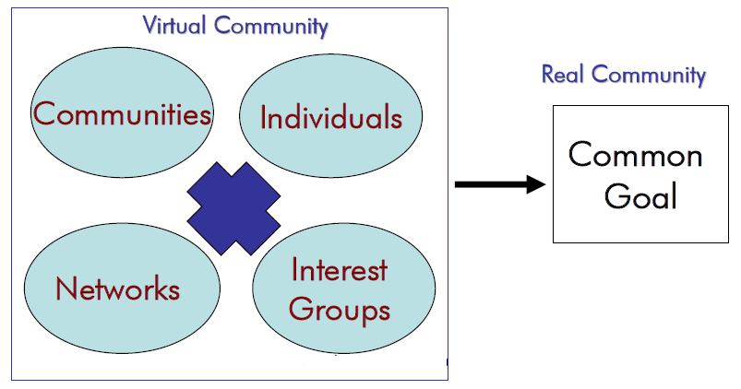
Mobilisation and Lobbying Model
Building Allies / Networking Networks for Concerted Action

Slide 40
Mobilization and Lobbying Model
• Principle
One of the most frequently used digital governance model and has often come to the aid of the civil society organizations in developing countries to impact international decision-making processes.
Based on planned, directed, strategic flow of information to build strong virtual allies to strengthen action in the real world.
Takes up the pro-active approach of forming virtual communities which share similar values and concerns, promoting active sharing of information between these communities, and linking them with real world activities.
The strength of this model is in the diversity of its virtual community, and the ideas, expertise and resources accumulated through virtual forms/methods of networking.
The model is able to mobilize and leverage human resource and information beyond geographical, institutional and bureaucratic barriers and use it for concerted (jointly arranged) action.
The model can effectively overcome institutional, geographical and bureaucratic barriers to shape rigorous action
The model also provides a strong virtual arm to several activities such as directing campaigns against a particular individual or decision-making body.

Slide 41
Mobilization and Lobbying Model
• Applications
Fostering/Compelling for public debates on global issues, themes of upcoming conferences, treaties etc.
Formation of pressure groups to pressurize decision makers to take/recognize their common concerns into cognizance (knowledge/awareness).
Amplifying the voices of marginalized/suppressed groups who are traditionally marginalized from decision making process.
Advocating for the rights of the marginalized groups from the decision-making organs
Building up wider participation/involvement in decision-making processes.
Developing global expertise on a particular theme in absence of localized information to aid decision- making.

Slide 42
Mobilization and Lobbying Model
Evaluation (Pros and Cons)
The model has grown tremendously since the onset of debates for the Seattle round of World Trade Organization (WTO) in 1999 when it saw the formation of several virtual communities to advocate the concerns of developing countries in the WTO agreement.
The display of a unified civil society force at Seattle was in many ways a result of intensive discussions that took place over virtual networks months prior to the summit.
The discussions taking place over the virtual network fed into regional level action plans that built into the global movement.
A Community may no longer find itself isolated but may find an ally for mobilizing effective action through this model.
The mobilization and lobbying model enhances the scope of participation of individuals and communities in policy issues and debates.
The model increases the range of membership of individuals and communities in debates and any policy issues

Slide 43
Mobilization and Lobbying Model
Evaluation (Pros and Cons)
The model also creates an effective deterrent (restriction) for government bodies and individuals to be watchful in their actions in case they turn the opinion of local and global community against them.
This model could be effectively used by the Government to encourage public debates and to gauge public opinion on a particular issue as a part of good governance strategies.

Slide 44
Organizations / Projects based on Mobilization and Lobbying Model
India
Panchayats: http://www.panchayats.org
A discussion list run by Indian professionals to discuss policy issues and case-studies relating to local livelihood strategies and decentralised natural resources management.
The participation is open and the list generates useful discussion between practitioners, activists and policy makers.
Global
Independent Media Centre: http://www.indymedia.org/
The Center was established by various independent and alternative media organisations to provide grassroots coverage of WTO-Seattle in 1999.
The Center acted as a clearinghouse of information for journalists, and provided up-to-the-minute reports, photos, audio and video footage through its website.

Slide 45
Organizations / Projects based on Mobilization and Lobbying Model
Global: Greenpeace Cyber-activist Community http://cybercentre.greenpeace.org/t/s/community_articles
The Greenpeace Cyberactivist Community has members from more than 170 countries and territories and is growing quickly.
It is an effort towards creation of virtual communities to mobilise global support against some of the disputable environmental policies/ actions of the Government.
Members receive email campaign updates, and can send letters to key corporate and political decision makers, download action kits, send e-cards to friends and colleagues, participate in on-line discussions, and play a significant role in helping to win environmental campaigns.
Global: IGC Internet http://www.igc.org
Institute for Global Communications (IGC) has changed the way the progressive community worked by introducing them to email, online discussions, mailing lists and the Web.
IGC Internet offers progressive individuals and groups a place on the Internet to learn, meet and organize.
At the moment, IGC Internet is changing to take its community of activists and non-profit professionals into the Internet's next wave by focusing on content, information sharing and new, collaborative tools.

Slide 46
Interactive-Service Model / Government to Citizen to Government Model (G2C2G)
Interactive-service system of government can also be referred to as Government to Citizen to Government model.
This model is a consolidation of different E-governance models and allows direct participation of persons in the digital governance process.
This model opens up possibilities for one-to-one and self-serviced participation of individuals in governance processes.
ICTs have the potential to bring every individual into a digital network and enable interactive (two-ways or multiple-ways) flow of information among them.

Slide 47
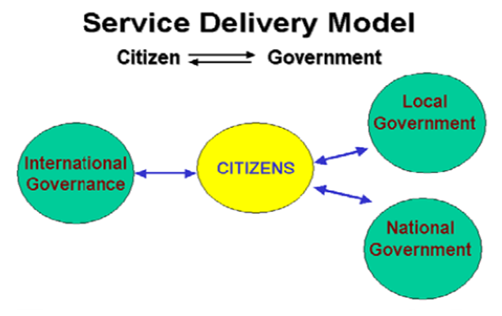
Interactive-Service Model / Government to Citizen to Government Model (G2C2G)

Slide 48
Interactive-Service Model / G2C2G
Principle
Interactive-Service model in many ways is a consolidation (combining) of the earlier digital governance models and opens up avenues for direct participation of individuals in the governance processes.
ICT have the potential to include every individual within a knowledge network and enable interactive communication channels among them.
As the participation is direct and not through representatives, it can bring greater objectivity and transparency in decision-making processes, and give a greater feeling of involvement and empowerment, provided that individuals are willing to engage in the governance processes.
This model fully captures the potential of ICT and leveraged it for greater participation,efficiency and transparency in functioning of the government as well as savings in time and costs relating to decision-making.
The Interactive-Service Model makes possible the various services offered by the Government to be directly accessible to the citizens in an interactive manner.

Slide 49
Interactive-Service Model / G2C2G
It does so by opening up an interactive Government to Consumer to Government (G2C2G) channel in various aspects of governance such as election of government officials (e-ballots); filing of tax returns, procurement of government services, decision to make on specific issues (eg: health plans), sharing of concerns and providing expertise; conducting opinion polls on public issues, gauging public mood and opinions, bringing mass awareness and grievance redressal.

Slide 50
Interactive-Service Model / G2C2G
Applications
Establishing an interactive communication channel with key policy-makers and members of planning commissions such as video-conferencing and online dialoguing.
Conducting electronic ballots for the election of government officials and other office bearers(person bearing position in organization).
Used in conducting public debates or opinion polls on issues of wider concern or on issues affecting the everyday citizens before formulation of policies and legislative frameworks.
Filing of grievances, feedback and reports by citizens to various the concerned governmental body.
Performing governance functions in an online platform such as revenue collection, filing of taxes, governmental procurement, payment transfers etc.
Carrying out video-conferencing, online discussion with policy makers.

Slide 51
Interactive-Service Model / G2C2G
Applications
Establishing decentralised forms of governance

Slide 52
Interactive-Service Model / G2C2G
Evaluation (Pros and Cons)
This model of governance is more applicable in the developed nations and has been projected for use in the developing countries.
The model firmly relies on the interactive applications of ICT and therefore is a technology and cost intensive model which will require a transition period before being adopted on a wider scale, especially in the developing countries.
The model is on the higher end of technology-reliance as compared to the other models.
It would also require elemental familiarity of ICT among the citizens to fully benefit from this model.
Nevertheless, the diminishing costs of ICT and the advantages offered by this technology would certainly catalyze the penetration of this model.

Slide 53
Interactive-Service Model / G2C2G
Evaluation (Pros And Cons)
Intermediary organizations, knowledge networkers and middlemen will play a tremendous role to play in widespread replication of this model.
This makes it difficult to replicate in developing countries in absence of individual and secure ICT access.

Slide 54
Organizations / Projects based on Interactive- Service Model / G2C2G
Philippine: Philippine Custom Reform:
http://www1.worldbank.org/publicsector/egov/philippinecustomscs.htm
The Philippines Customs Bureau has developed an on-line system to process clearance of imports, payment of duty, and delivery of release orders for shipments to leave the docks.
The new on-line system has lessened the cost of trade for businesses, reduced opportunities for fraud, and helped the Bureau to maximise revenue collection.
• India: Gyandoot: http://www.gyandoot.net/gyandoot/intranet.html
Gyandoot is an intranet in Dhar district of Madhya Pradesh connecting rural cybercafes catering to everyday needs of the masses.
The site offers several interactive governance related services to the local people such as providing Commodity/ Agricultural Marketing Information System, copies of land-maps, online registration of applications, and public grievance redressal.
It is a step towards tele-centre based e-governance models.

Slide 55
Evolution of E-Governance and Maturity Model
The E-Governance Maturity Model (EMM version 1.0 Anjali Dhingra and D.C. Mishra), based on conventional software maturity models, proposes some levels of maturity depending on the effectiveness with which the e-governance efforts have been initiated, implemented or successfully completed.
The model also provides identification of Key focus area that need to be concentrated for attaining(achieving) a specific maturity level as discussed below:
Traditionally e-Governance has been defined as an ICT enabled root to good governance with a view to enhancing transparency in the system and provide prompt and quality services to the citizen.
E-Governance is an evolutionary path whose effective implementation requires a complete understanding of its various elements and at the same time taking a holistic view(all aspects) to stay focused on all its overall objective.

Slide 56
Evolution of E-Governance and Maturity Model
E-Governance Journey encounters several milestones that need to be identified and modelled so that efforts invested can be assessed and an appropriate course of action be taken by the organization to further its way on the path of e-governance.
The E-governance Maturity Model (EMM version 1.0) proposes five levels of maturity, depending upon the effectiveness with which the e-governance efforts have been initiated, pursued, utilized and institutionalized.
EMM 1.0 will facilitate government organizations to access the current level of e-governance initiatives and accordingly make efforts for the future.
This capability maturity model can be used to measure the maturity of an organization’s IT governance and to assist its progress from the initial/ad-hoc state toward the optimized state.
The model further identifies the characteristics exhibited by organizations at various level of maturity that will facilitate correct assessment of the current status.

Slide 57
Maturity Model
• A maturity model is a method for judging the maturity of the processes of an organization and for identifying the key practices that are required to increase the maturity of these processes.
• An eGovernment maturity model provides us with guidance on how to gain control of our processes for developing and maintaining eGovernment services and how to evolve toward a culture of excellence in providing and managing eGovernment.
A maturity model can guide us in selecting process improvement strategies by determining current process maturity and identifying the few issues that are most critical to eGovernment quality and process improvement.
• By focusing on a limited set of activities and working aggressively to achieve them, we can steadily improve our organization-wide eGovernment processes and enable continuous and lasting gains in our eGovernment capabilities.
• Maturity models can be very involved and take years to master for good or bad, no well-developed maturity models for eGovernment exist; the best available models are simple, but still useful for understanding some key facts about eGovernment.

Slide 58
E-Governance Maturity Models (EMM)
– EMM (version 1.0- Anjali Dhingra and D.C. Mishra) proposes some levels of maturity, depending on the effectiveness with which the e-governance efforts have been initiated, implemented or successfully completed.
– The model also provides for identification of key focus areas that need to be concentrated for attaining a specific maturity level.
– The EMM version 1.0 proposes five levels of maturity, depending upon the effectiveness with which the e-governance efforts have been initiated, pursued, utilized and institutionalized.

Slide 59
Five Maturity Levels
• The E-governance maturity model (EMM-Version 1.0) is based on
Speed, openness and ubiquity (omnipresence) are the major capabilities of ICT which can be use for generating transparency, responsiveness and accountability in the system,on the one hand
Empowering the common man by providing faster access to right information at the right time,on the other hand
Service-oriented approach where public administration is seen as professional activity and efficient delivery of services to the internal and external users(customers) is emphasized as a key performance indicator of the government department.
The internal customers/users of an organization are its employees and the external users are citizens, business, other government and non governmental bodies that the organization needs to satisfy in its e-governance Endeavour.
The maturity levels described, provide a necessary mechanism to benchmark the efforts invested by an organization in implementing e-governance and subsequently sustaining it to the satisfaction of its customers/users.

Slide 60
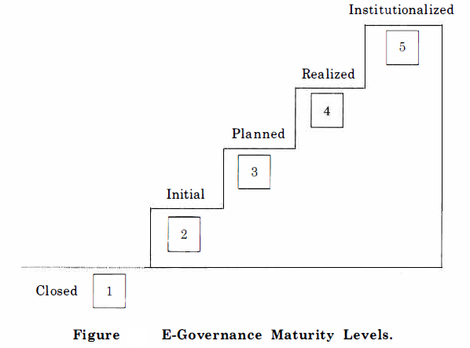
Five Maturity Levels

Slide 61
LEVEL 1: Closed
Here an organization does not use ICT as a facilitator for good governance and has no plans to do so in the near future.
• Such situation may arise due to lack of exposure to ICTs and associated benefits that again may depend upon a number of reasons: remoteness from the mainstream in terms of location,lack of resources and strategic thinking could be some of the other issues.
• As a result the organization is closed in terms of being connected and sharing of information in the context of “E-governance”.
• However, even in this condition the organization may be efficiently functioning.
Given the trend today, all organizations may take up ICT implementation sooner or later.

Slide 62
LEVEL 2: Initial
• This level corresponds to the stage when an organization has initiated the automation of its processes but on a ad-hoc basis.
• No organized efforts are made to undertake the e-governance initiatives.
• Also, Many of such efforts are abandoned due to lack of proper direction at a subsequent date.

Slide 63
LEVEL 3: Planned
• This level comprises of systematic approaches with clearly defined vision, objectives and goals for e-governance.
• Need assessments are conducted to prioritize the areas of implementation and measure the extent of e-readiness.
• Taking necessary input from need assessment study, extensive planning has been carried out indicating policies, strategies, various activities, stakeholders, roles and responsibilities and resources required in terms of time, money and manpower to undertake the e-governance exercise.
However the organization is yet to enter into the planned implementation of the e-governance exercise, even though all the requisite planning is completed.

Slide 64
LEVEL 4: Realized
• This level corresponds to the stage when the organization actually realizes the complete e-governance plan.
• Consequently, an integrated system is established where all the internal processes of the organization are computerized and there is a seamless information exchange among all concerned entities.
• The organization starts delivering the services to its external as well as internal customers in an effective manner.
• Complete realization of the plan, in a single instance, would entail enormous amount of resources in terms of time, money and manpower which may necessitate adopting a phased approach for operationalizing the e-governance services.
Accordingly a further classification within this level has been proposed that measures the extent of realization of the plan over a period of time.
These sub-levels are also indicative of openness and effectiveness with which the information is exchanged among various entities of organization(external and internal)

Slide 65
LEVEL 4: Realized (Contd…)
• Retrospected: At this level, the organization has retrospectively(survey or review of past) studied its business processes in view of its vision, overall e-governance objectives, the service-oriented approach and changes, if required, in the processes are initiated as a constant evolutionary process.
• E-ready: In this stage, e-readiness essentials, which are also the building blocks for e-governance, are ensured by the organization
E-readiness is the maturity of citizens, businesses, NGOs and governments for participating in the electronic world
• Partially open: At this stage some of the e-governance services are operationalized resulting in a partial information exchange among the entities both within and outside the organization.
• Open: This sub-level of realized state implies complete deployment of e-governance services that ensure an integrated system that is open to information exchange.
The focus here shifts from acquiring and implementing “e” enabling factors to effectiveness to deal with the customer needs and is accountable for its services.

Slide 66
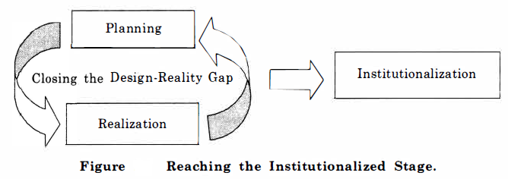
LEVEL 5: Institutionalized
• At this level, the organization sustains the realized state over a period of time so that e-governance becomes part of its work culture.
The e-governance services are effectively utilized and accepted by the users.
Several iterations between planned and realized state lead to institutionalization , when e-governance becomes a way of life.

Slide 67
LEVEL 5: Institutionalized (Contd..)
• E-Readiness Essentials
presence of strategic thinking, leadership and commitment among top-level decision makers
2. Institutional Infrastructure
3. ICT Infrastructure
4. Human Capacities
5. Legal Infrastructure

Slide 68
Characteristics of Maturity Levels
• Level 1: Closed
– Organization are closed to e-governance
– No plans or vision is available
– Continue with fully manual and conventional operation
• Level 2: Initial
– Organization lacks strategic thinking and direction for e-
governance at top level
– Unorganized and individual efforts of automation in some
areas
– Individual efforts sustains as long as the enthusiasm
remains and is often abandoned due to lack of direction
– Generally accumulate hardware without any planning and
much of it goes unutilized or underutilized

Slide 69
Characteristics of Maturity Levels
• Level 3: Planned
– E-governance becomes a part of organization’s agenda.
– Strategic thinking and leadership guide the e-
governance initiatives.
– Clear understanding of e-governance needs as
projected by the external and internal users.
– Extensive planning for implementing and
addressing the Key Focus Area (KFAs).
– Documentation including vision, scope, need
assessment survey, policy guidelines, action plan
and outsourcing guidelines.

Slide 70
Characteristics of Maturity Levels
• Level 4: Realized
– Retrospected:
• Business processes are attuned with the vision and overall
e-governance objective
• There is awareness about e-governance among all
concerned-the stakeholders as well as the users
– E-ready:
• The organization has a sound infrastructure in place
• Users motivated to use e-governance services
– Partially Open:
• Such organization sometimes focus only on their
internal processes, allowing information exchange
confined to the organization. In such case G2E is visible
where as G2C, G2G, G2B is not yet established.

Slide 71
Characteristics of Maturity Levels
• Level 4: Realized
– Open:
The organization has integrated system, reflective of smooth information exchange within and outside the organization.
G2E, G2C, G2G, G2B are well established.
Organization focuses on satisfying the users of e-governance.
The internal and external customers of organization start utilizing the e-governance services and become dependent on them.

Slide 72
Characteristics of Maturity Levels
• Level 5: Institutionalized
The e–governance system of the organization is driven by a well established Knowledge Management System that generated an ability in the organization to evolve with time in view of new requirements.
E-governance becomes an effortless exercise for the organization and it becomes a way of life for the stakeholders and customer/users.
The organization at this level is completely paperless

Slide 73
Towards Good Governance Through E-Governance Models
The former UN Secretary General Kofi Annan describes good governance as a force ensuring respect for human rights and the rule of law, strengthening democracy, promoting transparency and capacity in public administration.
Good governance is a term different to governance which is mainly a political and technocratic term without normative aspirations and suggests that governance should be good and not bad.
Good Governance may be defined as the processes that guide the political and socio-economic relationships, with commitment to democratic values, trusted services and just and honest business.

Slide 74
Towards Good Governance Through E-Governance Models
• E-governance (Electronic Governance/ Digital Governance) has been recognized as a vital force for transformational improvement in quality, efficiency and effectiveness of governance.
A governance strategy driven by information and communication technology has to be developed and applied with the objective of bringing in more transparency and increased accountability.
The digital governance models bring about a transformation in the existing forms of governance as they change the nature of citizen-governance relationship and bring in new agents and mechanisms to influence the governance processes.
• The models foster democratic control over the government’s economic, social and welfare policies by citizens and civil society organizations - a key process requirement for good and responsive governance.
• It ensures that the voices of people are more likely to be reflected in decision-making processes.

Slide 75
Towards Good Governance Through E-Governance Models
Richard Heeks studied the effect of new information and communication technologies and how it can make a significant contribution to the achievement of good governance goals.
He outlined the three main contributions of e-governance: improving government processes (e-administration), connecting citizens (e-citizens and e-services), and building external interactions (e-society).
Case studies are used to show that e-governance is a current, not just future reality for developing countries.

Slide 76
Towards Good Governance Through E-Governance Models
The changes brought about in the citizen-governance relationship through digital governance are four fold:
1. They open up avenues/making progress for flow of information both vertically and laterally, and thus encompass a wider foundation of the civil society.
A greater density of information flow is achieved between government and civil society or within the civil society itself.
The right to voice and expression therefore gets more frequently exercised by citizens who wish to engage in the political processes through digital process.
2. Information becomes difficult to be capitalized by a few for political gains and at the expense of ignorance of citizens.
Digital governance ensures that the power-equations shift from being concentrated and restricted at selected nodes to its more even and timely distribution among citizens, opposition parties and watch guard groups.

Slide 77
Towards Good Governance Through E-Governance Models
There is a greater scope to influence policy-makers and members of the civil society through collective opinion, direct participation, participation in public debates, and use of advocacy tools.
Legal advocacy includes law suits, legal memoranda, legal rights booklets for lay citizens, civil rights statements, legal representation and other negotiations, and legal advice.
4. Policy-makers become more aware of the voices of people and can effectively involve them in policy-making mechanisms.
They realize that their actions are under the scrutiny of many more watch guard organizations and there are greater avenues available with people to obtain or triangulate information from different sources.
Information also becomes difficult to obliterate/destroy and is forever archived to increase the institutional memory of the society.
It may however be noted that all these features described are applicable only to well established democracies with sound systems in place.
This criterion may not be applicable to many developing countries and even some developed countries.

Slide 78
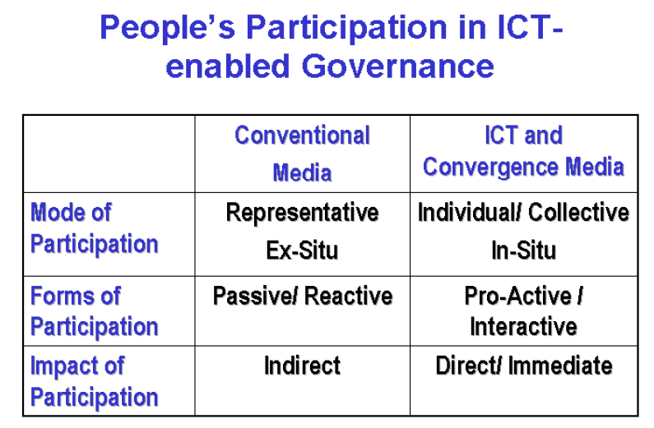
Towards Good Governance Through E-Governance Models

Slide 79
Towards Good Governance Through E-Governance Models
As seen from the comparison chart, the involvement of people in ICT enabled governance mechanisms is significantly different in comparison to traditional forms of governance.
The mode of governance transforms from ‘representative’ to ‘individual’ based and from ‘passive’ to ‘proactive’.
People are no longer totally dependent on information provided to them by their leaders or policy makers through conventional media to form an opinion about the issue.
They are able to capitalize on different sources of information and can proactively enter into a dialogue with decision makers on issues of interest to them.
Since ICT-enabled governance models can directly connect individuals with officials in the government and decision makers, the impact is immediate, and puts greater access and control over governance mechanism in the hands of individuals.

Slide 80
Towards Good Governance Through E-Governance Models
Spaces therefore get created within the existing governance mechanisms that would be democratically informed by citizen’s voice. This process makes the government more responsible and accountable to its citizens.
Digital governance models bring with them the potential to bring in far-reaching changes in governance structures in developing countries.
The approach to it however has to be cautious and well throughout.
Simple replication of popular e-governance models of the developed world in the developing world will not be effective and may end up marginalizing who are on the wrong side of the digital divide.
Local needs and priorities should guide the selection and nature of implementation of e-governance models in an evolutionary manner.
Creativity lies in the use of information and blending it with the potential offered by ICT to create customized low cost digital governance models.
Solutions may often emerge by analysis of reasons behind governance failures by the people themselves and then imaginatively using digital governance models to focus on the weakest spot to bring gradual improvements in governance.
Small successes are significant landmark in the path of transformation to good governance.

Slide 81
THANK YOU

